Slide 1
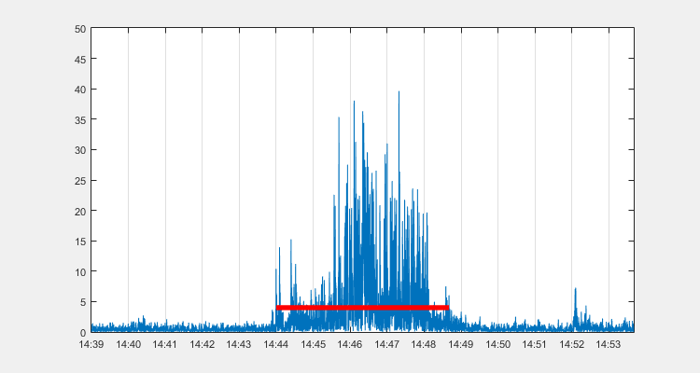
Notes:
t > 1 sec
G78151_V1N2

Slide 2
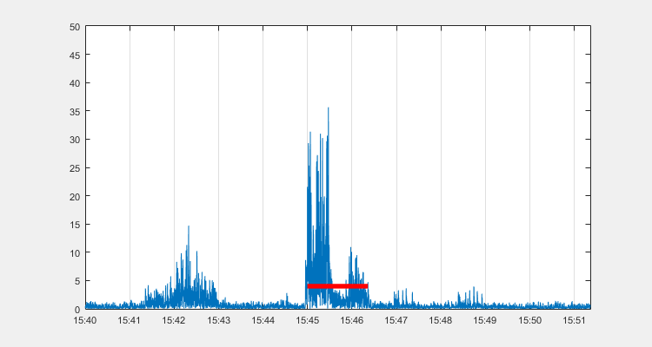
Notes:
0.75 < t < 1 sec
G78151_V1N2

Slide 3
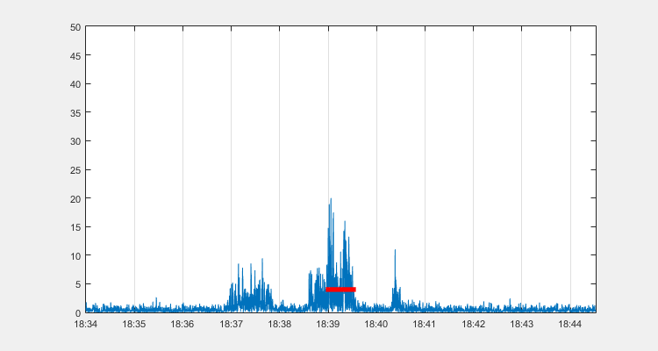
Notes:
0.5 < t < 0.75 sec
G78151_V1N2

Slide 4
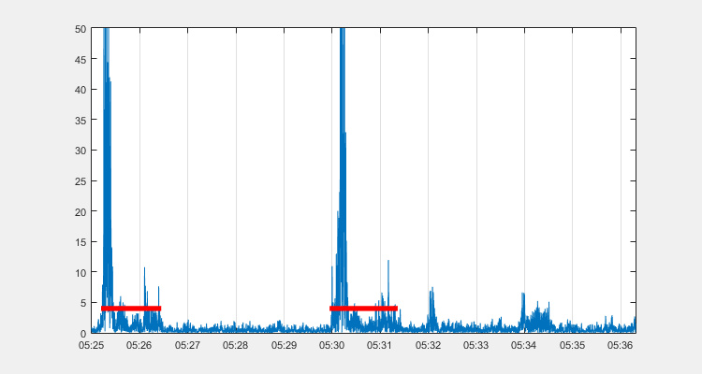
Notes:
0.25 < t < 0.5 sec
G78151_V1N2

Slide 5
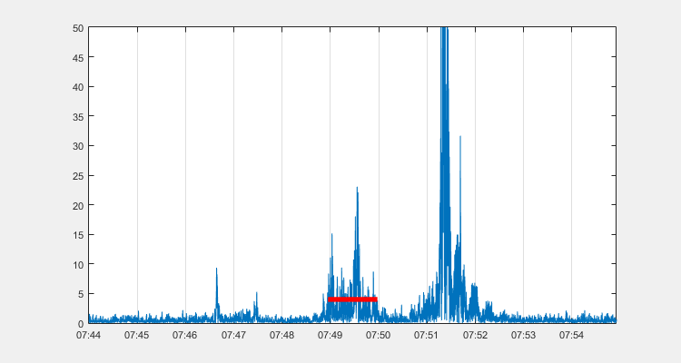
Notes:
t < 0.25 sec (emptiest)
G78151_V1N2

Slide 6
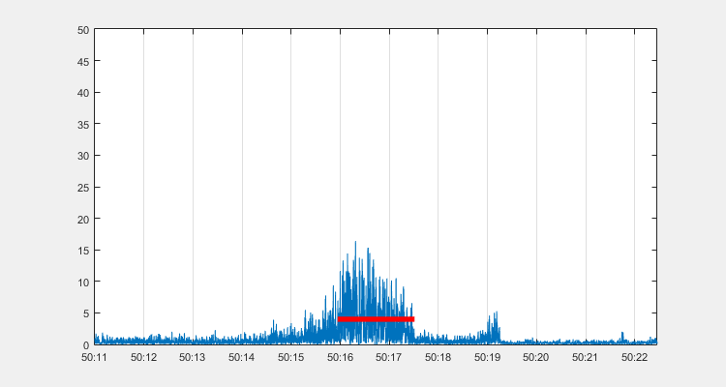
Notes:
t > 1 sec
G78151_V1N2

Slide 7
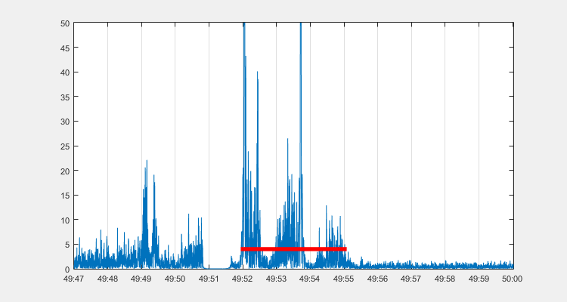
Notes:
0.75 < t < 1 sec
G78151_V1N2

Slide 8
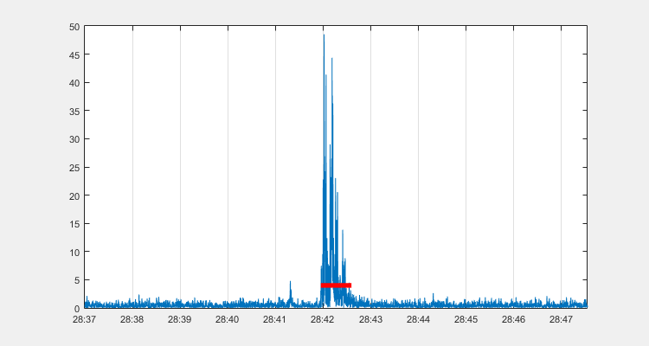
Notes:
0.5 < t < 0.75 sec
G78151_V1N2

Slide 9
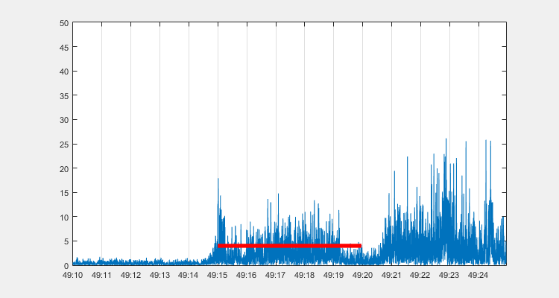
Notes:
0.25 < t < 0.5 sec
G78151_V1N2

Slide 10
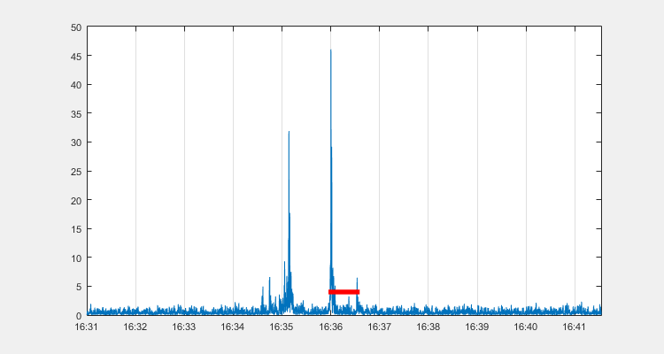
Notes:
t < 0.25 sec (emptiest)
G78151_V1N2

Slide 11
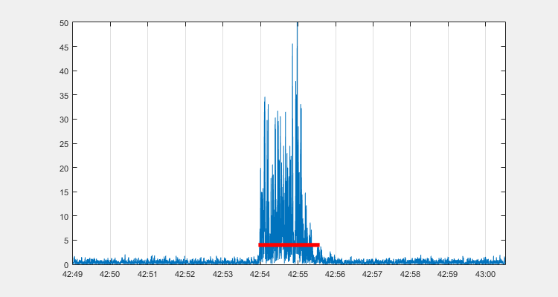
Notes:
t > 1 sec
G73879_V1N2

Slide 12
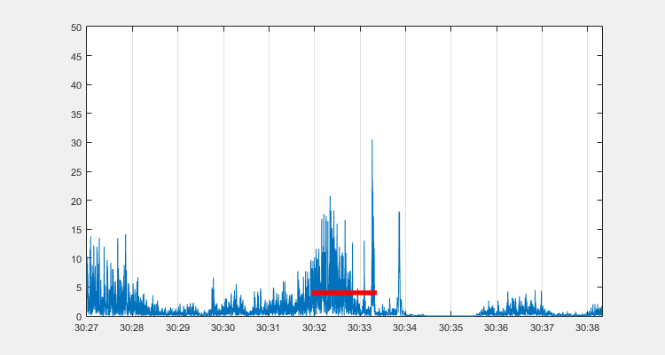
Notes:
0.75 < t < 1 sec
G73879_V1N2

Slide 13
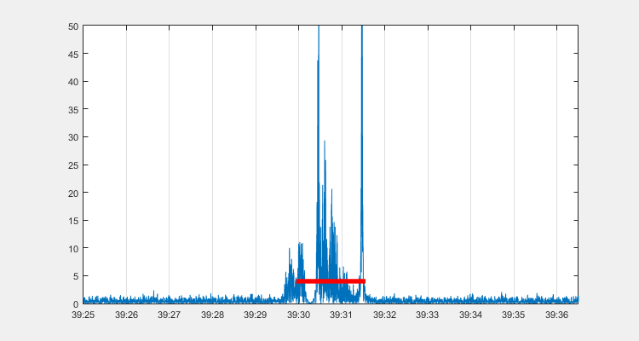
Notes:
0.5 < t < 0.75 sec
G73879_V1N2

Slide 14
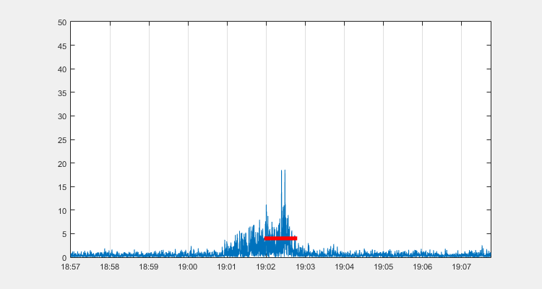
Notes:
0.25 < t < 0.5 sec
G73879_V1N2

Slide 15
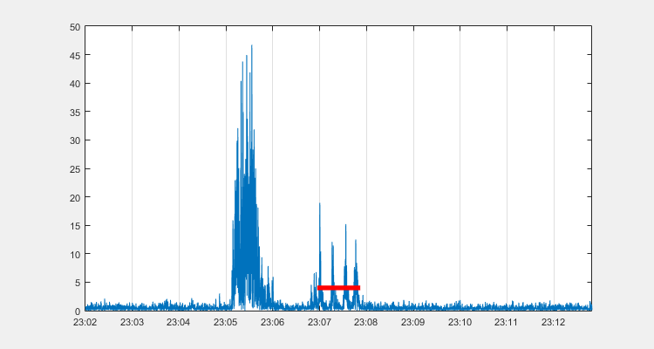
Notes:
t < 0.25 sec (emptiest)
G73879_V1N2

Slide 16
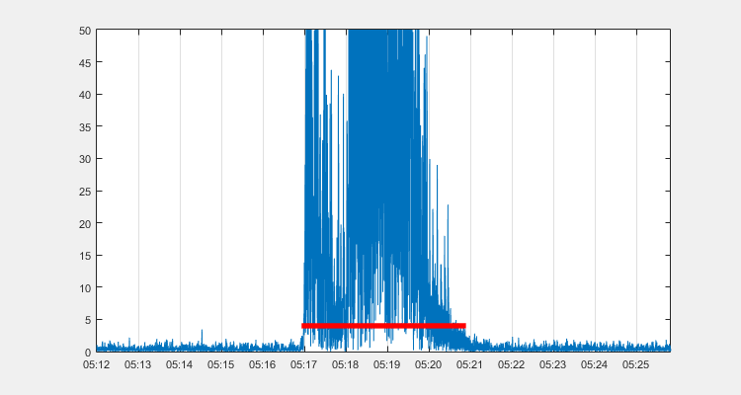
Notes:
t > 1 sec
G73879_V1N2

Slide 17
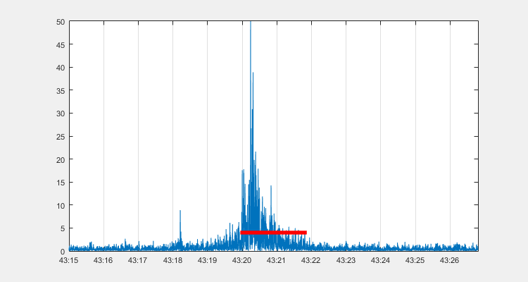
Notes:
0.75 < t < 1 sec
G73879_V1N2

Slide 18
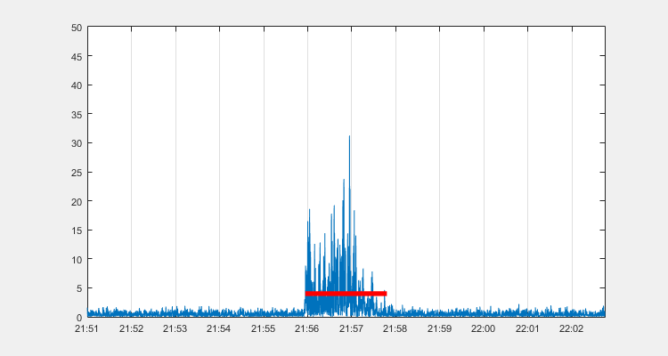
Notes:
0.5 < t < 0.75 sec
G73879_V1N2

Slide 19
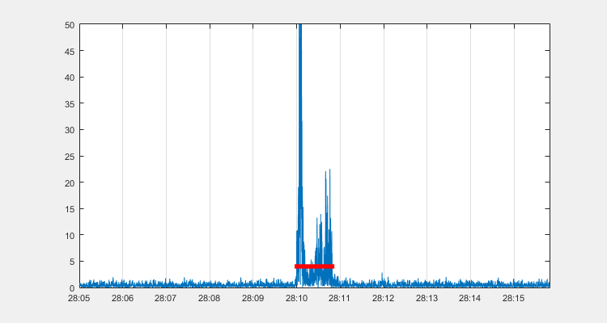
Notes:
0.25 < t < 0.5 sec
G73879_V1N2

Slide 20
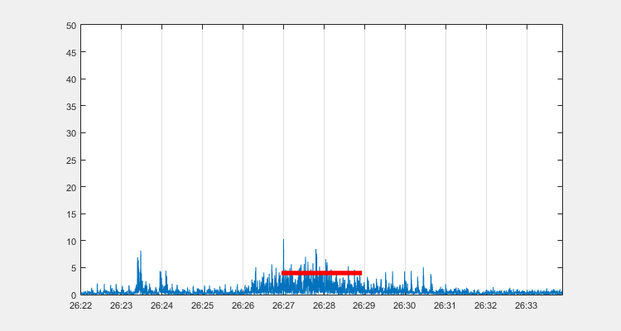
Notes:
t < 0.25 sec (emptiest)
G73879_V1N2

Slide 21
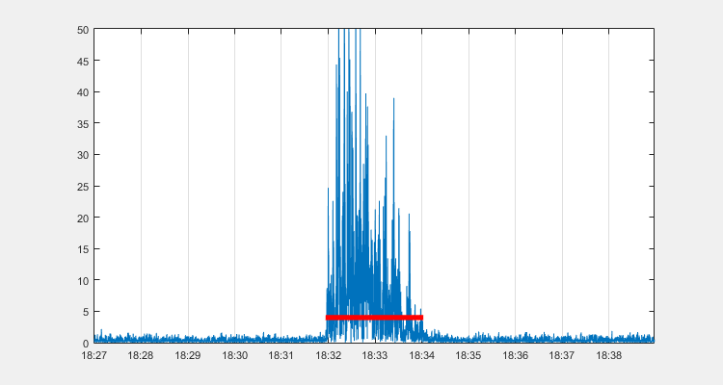
Notes:
t > 1 sec
G98446_V1N2

Slide 22
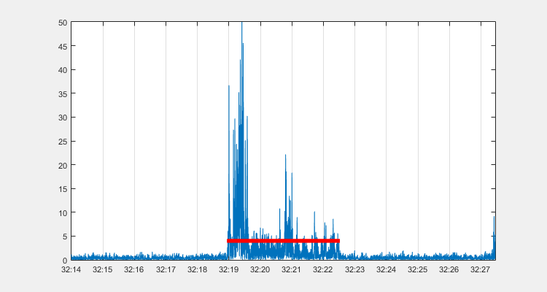
Notes:
0.75 < t < 1 sec
G98446_V1N2

Slide 23
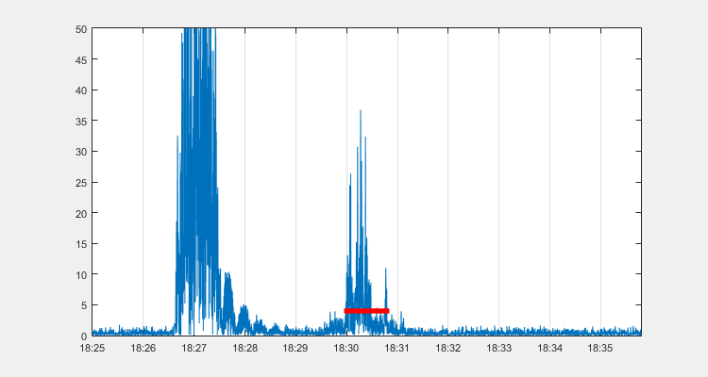
Notes:
0.5 < t < 0.75 sec
G98446_V1N2

Slide 24
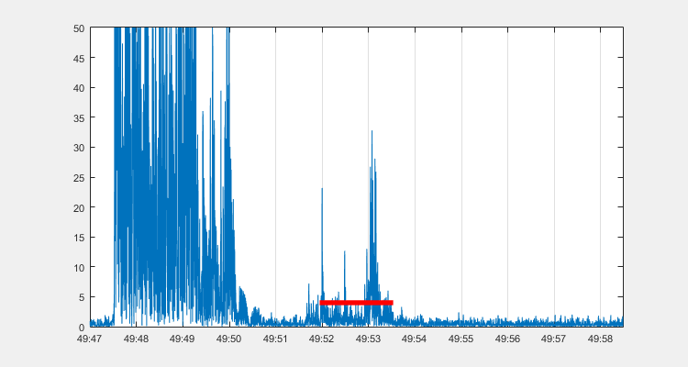
Notes:
0.25 < t < 0.5 sec
G98446_V1N2

Slide 25
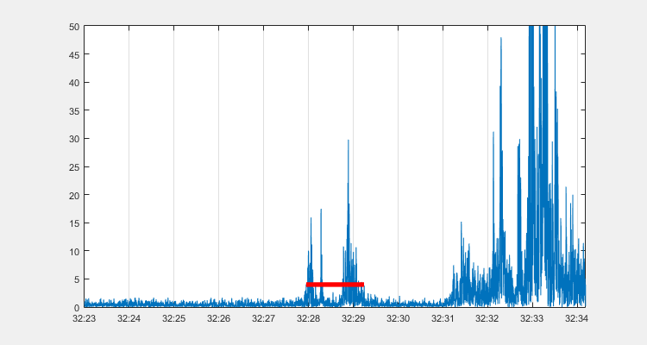
Notes:
t < 0.25 sec (emptiest)
G98446_V1N2

Slide 26
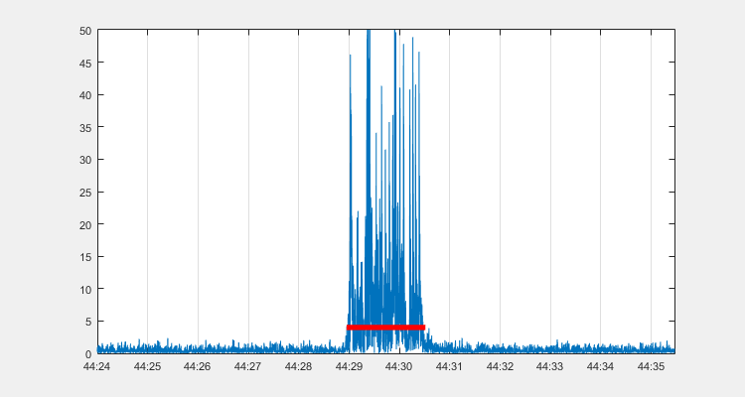
Notes:
t > 1 sec
G98446_V1N2

Slide 27
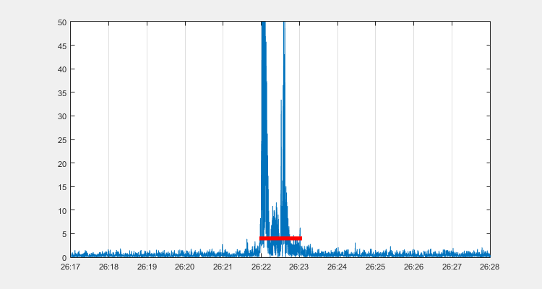
Notes:
0.75 < t < 1 sec
G98446_V1N2

Slide 28
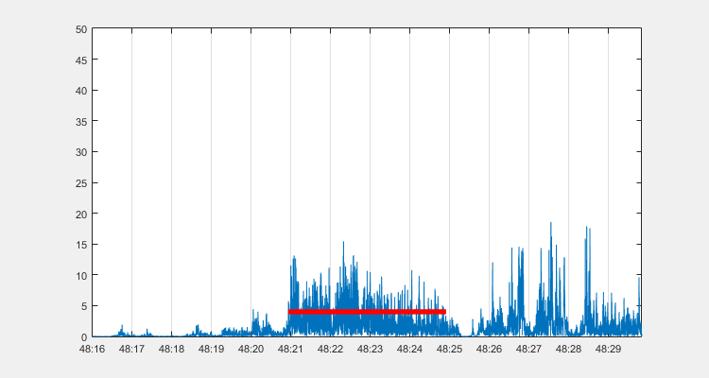
Notes:
0.5 < t < 0.75 sec
G98446_V1N2

Slide 29
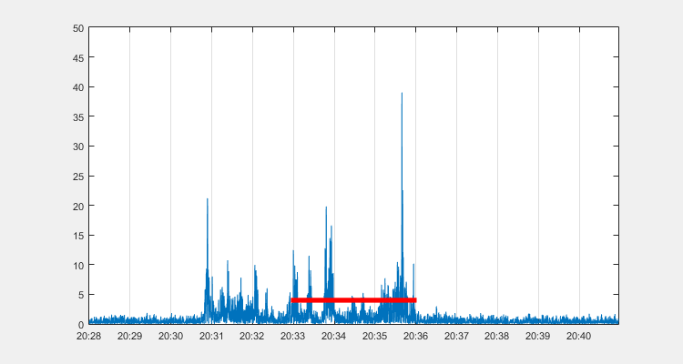
Notes:
0.25 < t < 0.5 sec
G98446_V1N2

Slide 30
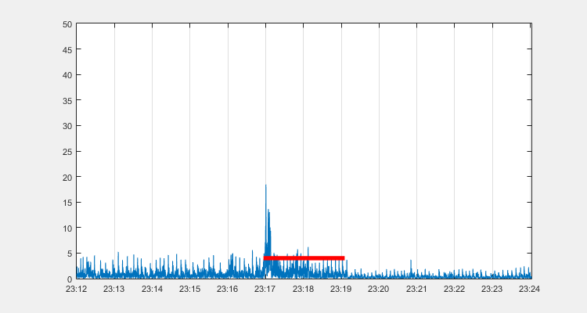
Notes:
t < 0.25 sec (emptiest)
G98446_V1N2

Slide 31
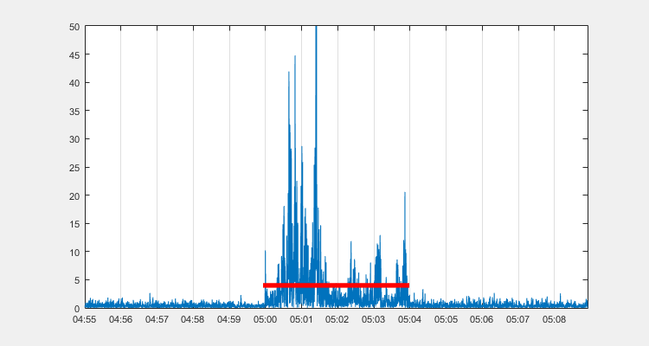
Notes:
t > 1 sec
G45848_V1N2

Slide 32
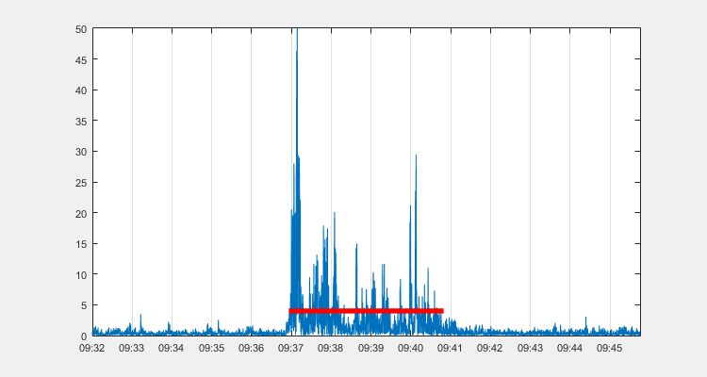
Notes:
0.75 < t < 1 sec
G45848_V1N2

Slide 33
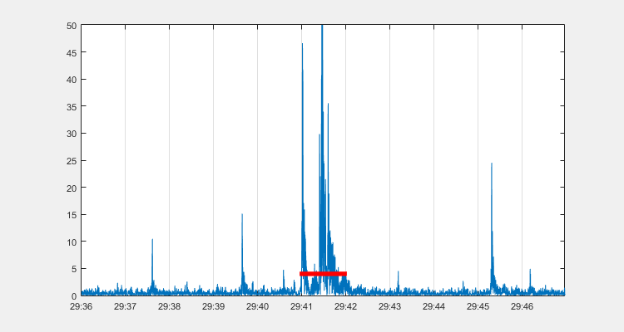
Notes:
0.5 < t < 0.75 sec
G45848_V1N2

Slide 34
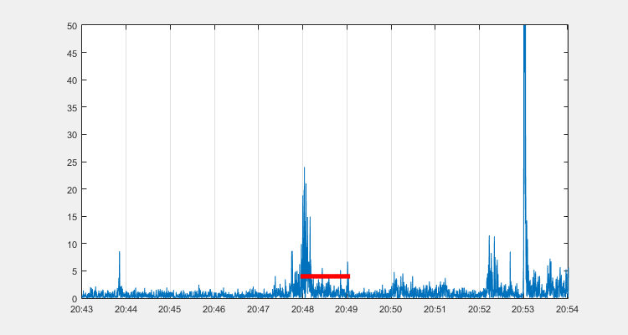
Notes:
0.25 < t < 0.5 sec
G45848_V1N2

Slide 35
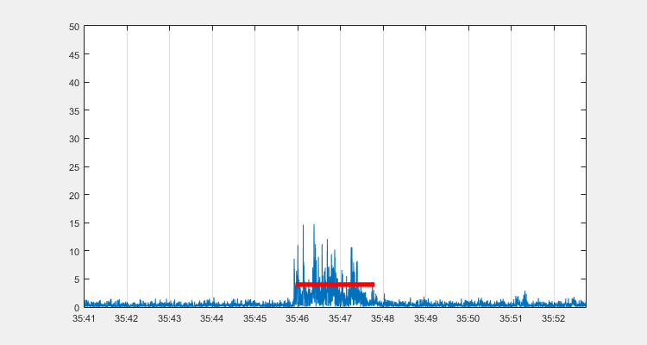
Notes:
t < 0.25 sec (emptiest)
G45848_V1N2

Slide 36

Notes:
t > 1 sec
G45848_V1N2

Slide 37
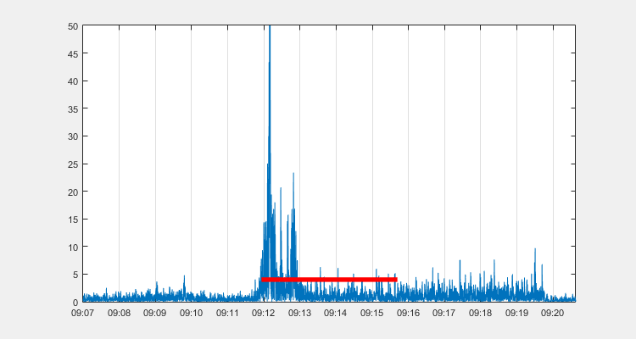
Notes:
0.75 < t < 1 sec
G45848_V1N2

Slide 38
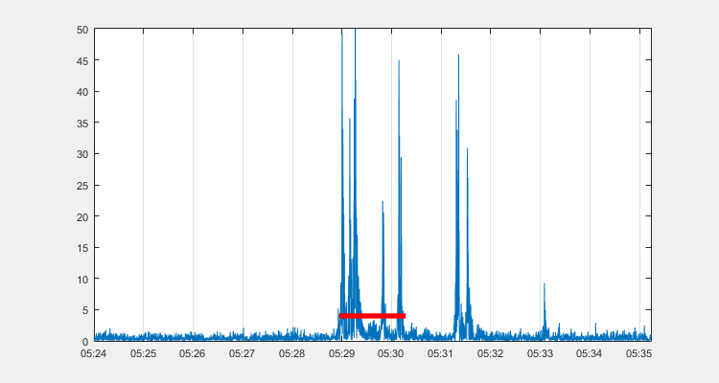
Notes:
0.5 < t < 0.75 sec
G45848_V1N2

Slide 39
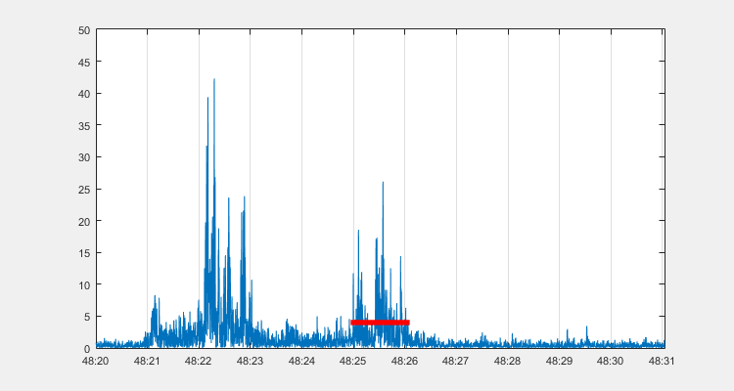
Notes:
0.25 < t < 0.5 sec
G45848_V1N2

Slide 40
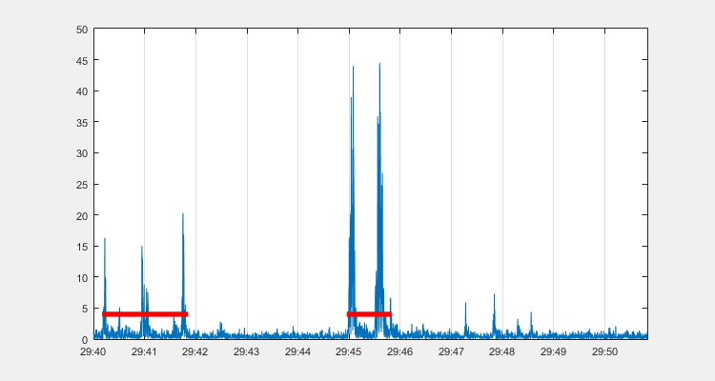
Notes:
t < 0.25 sec (emptiest)
G45848_V1N2

Slide 41
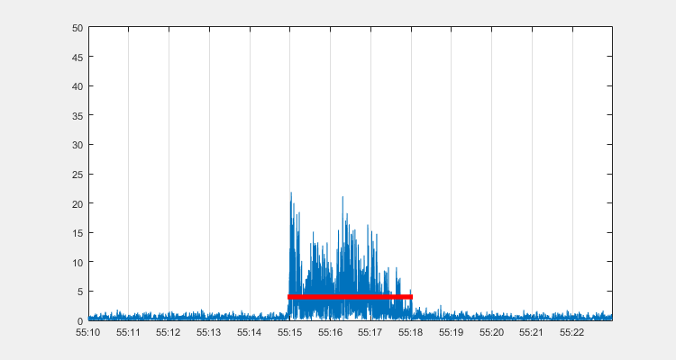
Notes:
t > 1 sec
G62534_V1N2

Slide 42
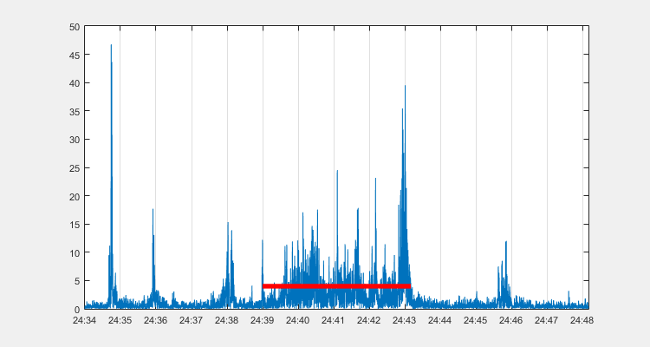
Notes:
0.75 < t < 1 sec
G62534_V1N2

Slide 43
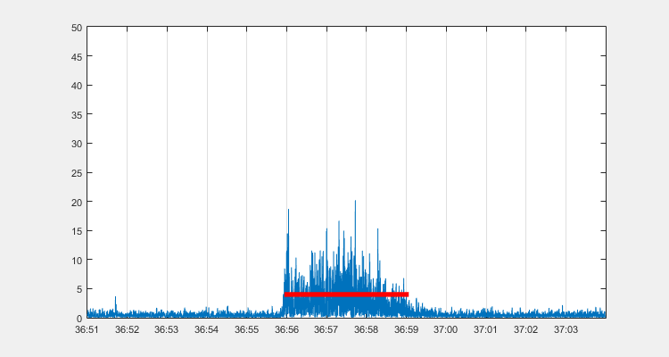
Notes:
0.5 < t < 0.75 sec
G62534_V1N2

Slide 44
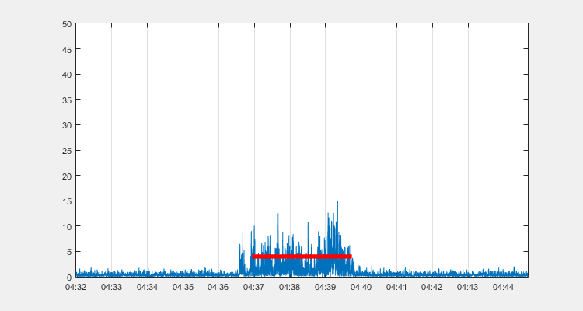
Notes:
0.25 < t < 0.5 sec
G62534_V1N2

Slide 45
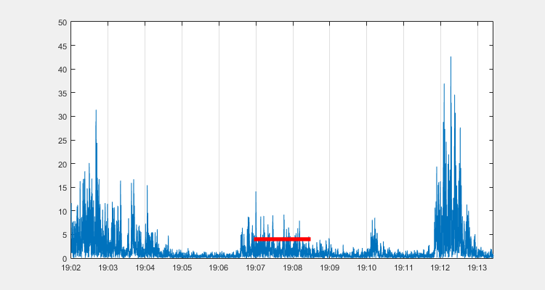
Notes:
t < 0.25 sec (emptiest)
G62534_V1N2

Slide 46
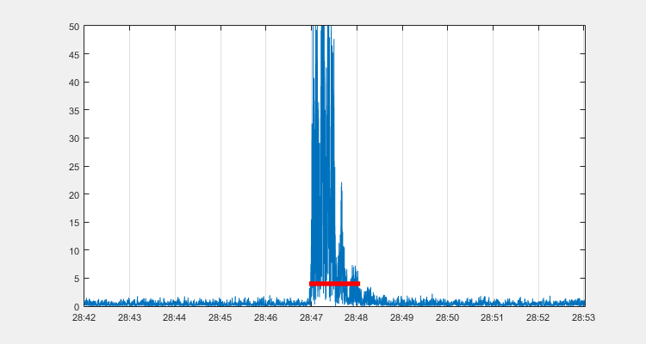
Notes:
t > 1 sec
G62534_V1N2

Slide 47
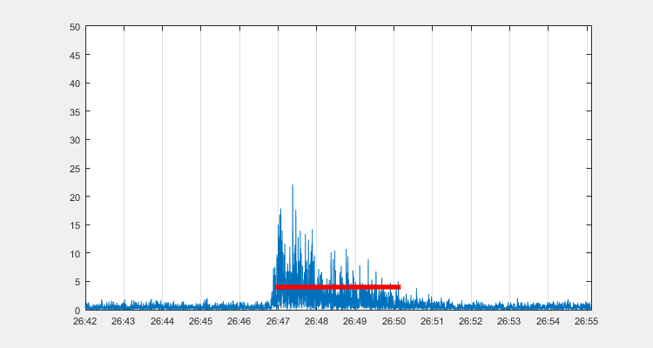
Notes:
0.75 < t < 1 sec
G62534_V1N2

Slide 48
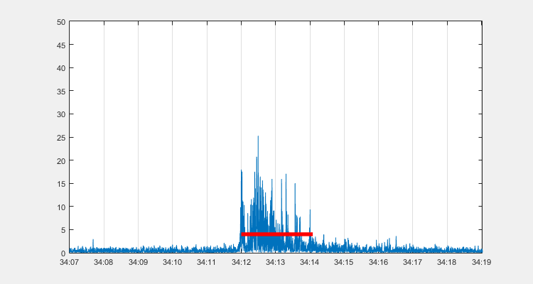
Notes:
0.5 < t < 0.75 sec
G62534_V1N2

Slide 49
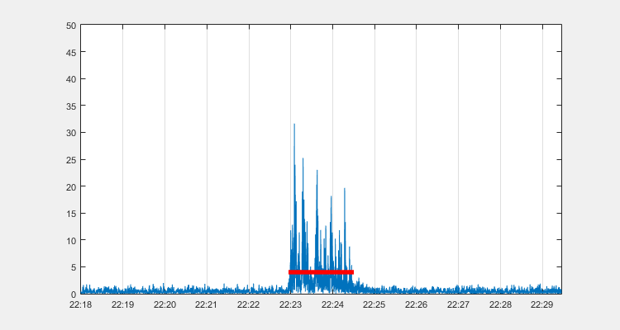
Notes:
0.25 < t < 0.5 sec
G62534_V1N2

Slide 50
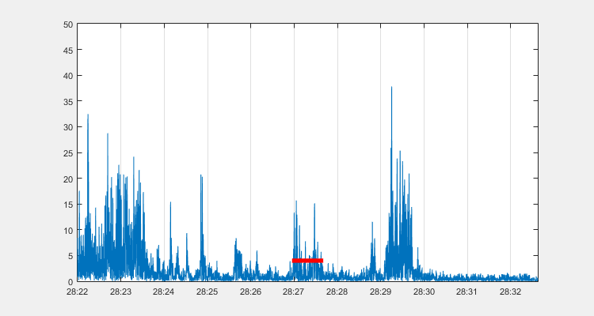
Notes:
t < 0.25 sec (emptiest)
G62534_V1N2

Slide 51
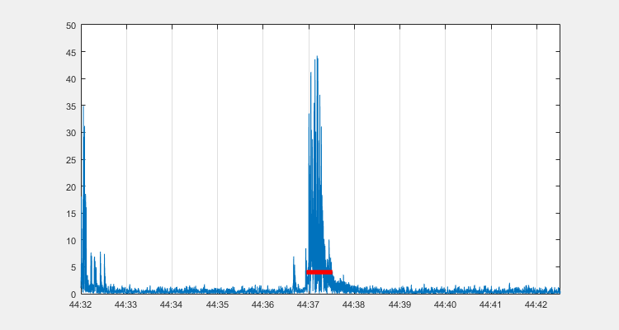
Notes:
t > 1 sec
G58925_V1N2

Slide 52

Notes:
0.75 < t < 1 sec
G58925_V1N2

Slide 53

Notes:
0.5 < t < 0.75 sec
G58925_V1N2

Slide 54

Notes:
0.25 < t < 0.5 sec
G58925_V1N2

Slide 55

Notes:
t < 0.25 sec (emptiest)
G58925_V1N2

Slide 56

Notes:
t > 1 sec
G58925_V1N2

Slide 57

Notes:
0.75 < t < 1 sec
G58925_V1N2

Slide 58

Notes:
0.5 < t < 0.75 sec
G58925_V1N2

Slide 59

Notes:
0.25 < t < 0.5 sec
G58925_V1N2

Slide 60

Notes:
t < 0.25 sec (emptiest)
G58925_V1N2

Slide 61

Notes:
t > 1 sec
G10600_V1N2

Slide 62

Notes:
0.75 < t < 1 sec
G10600_V1N2

Slide 63

Notes:
0.5 < t < 0.75 sec
G10600_V1N2

Slide 64

Notes:
0.25 < t < 0.5 sec
G10600_V1N2

Slide 65

Notes:
t < 0.25 sec (emptiest)
G10600_V1N2

Slide 66

Notes:
t > 1 sec
G10600_V1N2

Slide 67

Notes:
0.75 < t < 1 sec
G10600_V1N2

Slide 68

Notes:
0.5 < t < 0.75 sec
G10600_V1N2

Slide 69

Notes:
0.25 < t < 0.5 sec
G10600_V1N2

Slide 70

Notes:
t < 0.25 sec (emptiest)
G10600_V1N2

Slide 71

Notes:
t > 1 sec
G81096_V1N2

Slide 72

Notes:
0.75 < t < 1 sec
G81096_V1N2

Slide 73

Notes:
0.5 < t < 0.75 sec
G81096_V1N2

Slide 74

Notes:
0.25 < t < 0.5 sec
G81096_V1N2

Slide 75

Notes:
t < 0.25 sec (emptiest)
G81096_V1N2

Slide 76

Notes:
t > 1 sec
G81096_V1N2

Slide 77

Notes:
0.75 < t < 1 sec
G81096_V1N2

Slide 78

Notes:
0.5 < t < 0.75 sec
G81096_V1N2

Slide 79

Notes:
0.25 < t < 0.5 sec
G81096_V1N2

Slide 80

Notes:
t < 0.25 sec (emptiest)
G81096_V1N2

Slide 81

Notes:
t > 1 sec
G53584_V1N2

Slide 82

Notes:
0.75 < t < 1 sec
G53584_V1N2

Slide 83

Notes:
0.5 < t < 0.75 sec
G53584_V1N2

Slide 84

Notes:
0.25 < t < 0.5 sec
G53584_V1N2

Slide 85

Notes:
t < 0.25 sec (emptiest)
G53584_V1N2

Slide 86

Notes:
t > 1 sec
G53584_V1N2

Slide 87

Notes:
0.75 < t < 1 sec
G53584_V1N2

Slide 88

Notes:
0.5 < t < 0.75 sec
G53584_V1N2

Slide 89

Notes:
0.25 < t < 0.5 sec
G53584_V1N2

Slide 90

Notes:
t < 0.25 sec (emptiest)
G53584_V1N2

Slide 91

Notes:
t > 1 sec
G10600_V1N2

Slide 92
Notes:
0.75 < t < 1 sec
G10600_V1N2

Slide 93

Notes:
0.5 < t < 0.75 sec
G10600_V1N2

Slide 94

Notes:
0.25 < t < 0.5 sec
G10600_V1N2

Slide 95

Notes:
t < 0.25 sec (emptiest)
G10600_V1N2

Slide 96

Notes:
t > 1 sec
G10600_V1N2

Slide 97
Notes:
0.75 < t < 1 sec
G10600_V1N2

Slide 98

Notes:
0.5 < t < 0.75 sec
G10600_V1N2

Slide 99

Notes:
0.25 < t < 0.5 sec
G10600_V1N2

Slide 100

Notes:
t < 0.25 sec (emptiest)
G10600_V1N2

Slide 101

Notes:
t > 1 sec
G13805_V1N2

Slide 102

Notes:
0.75 < t < 1 sec
G13805_V1N2

Slide 103

Notes:
0.5 < t < 0.75 sec
G13805_V1N2

Slide 104

Notes:
0.25 < t < 0.5 sec
G13805_V1N2

Slide 105

Notes:
t < 0.25 sec (emptiest)
G13805_V1N2

Slide 106

Notes:
t > 1 sec
G13805_V1N2

Slide 107

Notes:
0.75 < t < 1 sec
G13805_V1N2

Slide 108

Notes:
0.5 < t < 0.75 sec
G13805_V1N2

Slide 109

Notes:
0.25 < t < 0.5 sec
G13805_V1N2

Slide 110

Notes:
t < 0.25 sec (emptiest)
G13805_V1N2

Slide 111

Notes:
t > 1 sec
G78151_V1N2

Slide 112

Notes:
0.75 < t < 1 sec
G78151_V1N2

Slide 113

Notes:
0.5 < t < 0.75 sec
G78151_V1N2

Slide 114

Notes:
0.25 < t < 0.5 sec
G78151_V1N2

Slide 115

Notes:
t < 0.25 sec (emptiest)
G78151_V1N2

Slide 116

Notes:
t > 1 sec
G78151_V1N2

Slide 117

Notes:
0.75 < t < 1 sec
G78151_V1N2

Slide 118

Notes:
0.5 < t < 0.75 sec
G78151_V1N2

Slide 119

Notes:
0.25 < t < 0.5 sec
G78151_V1N2

Slide 120

Notes:
t < 0.25 sec (emptiest)
G78151_V1N2

Slide 121

Notes:
t > 1 sec
G13805_V1N2

Slide 122

Notes:
0.75 < t < 1 sec
G13805_V1N2

Slide 123

Notes:
0.5 < t < 0.75 sec
G13805_V1N2

Slide 124

Notes:
0.25 < t < 0.5 sec
G13805_V1N2

Slide 125

Notes:
t < 0.25 sec (emptiest)
G13805_V1N2

Slide 126

Notes:
t > 1 sec
G13805_V1N2

Slide 127

Notes:
0.75 < t < 1 sec
G13805_V1N2

Slide 128

Notes:
0.5 < t < 0.75 sec
G13805_V1N2

Slide 129

Notes:
0.25 < t < 0.5 sec
G13805_V1N2

Slide 130

Notes:
t < 0.25 sec (emptiest)
G13805_V1N2

Slide 131

Notes:
t > 1 sec
G98446_V1N2

Slide 132

Notes:
0.75 < t < 1 sec
G98446_V1N2

Slide 133

Notes:
0.5 < t < 0.75 sec
G98446_V1N2

Slide 134

Notes:
0.25 < t < 0.5 sec
G98446_V1N2

Slide 135

Notes:
t < 0.25 sec (emptiest)
G98446_V1N2

Slide 136

Notes:
t > 1 sec
G98446_V1N2

Slide 137

Notes:
0.75 < t < 1 sec
G98446_V1N2

Slide 138

Notes:
0.5 < t < 0.75 sec
G98446_V1N2

Slide 139

Notes:
0.25 < t < 0.5 sec
G98446_V1N2

Slide 140

Notes:
t < 0.25 sec (emptiest)
G98446_V1N2

Slide 141

Notes:
t > 1 sec
G81096_V1N2

Slide 142

Notes:
0.75 < t < 1 sec
G81096_V1N2

Slide 143

Notes:
0.5 < t < 0.75 sec
G81096_V1N2

Slide 144

Notes:
0.25 < t < 0.5 sec
G81096_V1N2

Slide 145

Notes:
t < 0.25 sec (emptiest)
G81096_V1N2

Slide 146

Notes:
t > 1 sec
G81096_V1N2

Slide 147

Notes:
0.75 < t < 1 sec
G81096_V1N2

Slide 148

Notes:
0.5 < t < 0.75 sec
G81096_V1N2

Slide 149

Notes:
0.25 < t < 0.5 sec
G81096_V1N2

Slide 150

Notes:
t < 0.25 sec (emptiest)
G81096_V1N2

Slide 151

Notes:
t > 1 sec
G39699_V1N2

Slide 152

Notes:
0.75 < t < 1 sec
G39699_V1N2

Slide 153

Notes:
0.5 < t < 0.75 sec
G39699_V1N2

Slide 154

Notes:
0.25 < t < 0.5 sec
G39699_V1N2

Slide 155

Notes:
t < 0.25 sec (emptiest)
G39699_V1N2

Slide 156

Notes:
t > 1 sec
G39699_V1N2

Slide 157

Notes:
0.75 < t < 1 sec
G39699_V1N2

Slide 158

Notes:
0.5 < t < 0.75 sec
G39699_V1N2

Slide 159

Notes:
0.25 < t < 0.5 sec
G39699_V1N2

Slide 160

Notes:
t < 0.25 sec (emptiest)
G39699_V1N2

Slide 161

Notes:
t > 1 sec
G83896_V1N2

Slide 162

Notes:
0.75 < t < 1 sec
G83896_V1N2

Slide 163

Notes:
0.5 < t < 0.75 sec
G83896_V1N2

Slide 164

Notes:
0.25 < t < 0.5 sec
G83896_V1N2

Slide 165

Notes:
t < 0.25 sec (emptiest)
G83896_V1N2

Slide 166

Notes:
t > 1 sec
G83896_V1N2

Slide 167

Notes:
0.75 < t < 1 sec
G83896_V1N2

Slide 168

Notes:
0.5 < t < 0.75 sec
G83896_V1N2

Slide 169

Notes:
0.25 < t < 0.5 sec
G83896_V1N2

Slide 170

Notes:
t < 0.25 sec (emptiest)
G83896_V1N2

Slide 171

Notes:
t > 1 sec
G68538_V1N2

Slide 172

Notes:
0.75 < t < 1 sec
G68538_V1N2

Slide 173

Notes:
0.5 < t < 0.75 sec
G68538_V1N2

Slide 174

Notes:
0.25 < t < 0.5 sec
G68538_V1N2

Slide 175

Notes:
t < 0.25 sec (emptiest)
G68538_V1N2

Slide 176

Notes:
t > 1 sec
G68538_V1N2

Slide 177

Notes:
0.75 < t < 1 sec
G68538_V1N2

Slide 178

Notes:
0.5 < t < 0.75 sec
G68538_V1N2

Slide 179

Notes:
0.25 < t < 0.5 sec
G68538_V1N2

Slide 180

Notes:
t < 0.25 sec (emptiest)
G68538_V1N2

Slide 181

Notes:
t > 1 sec
G84560_V1N2

Slide 182

Notes:
0.75 < t < 1 sec
G84560_V1N2

Slide 183

Notes:
0.5 < t < 0.75 sec
G84560_V1N2

Slide 184

Notes:
0.25 < t < 0.5 sec
G84560_V1N2

Slide 185

Notes:
t < 0.25 sec (emptiest)
G84560_V1N2

Slide 186

Notes:
t > 1 sec
G84560_V1N2

Slide 187

Notes:
0.75 < t < 1 sec
G84560_V1N2

Slide 188

Notes:
0.5 < t < 0.75 sec
G84560_V1N2

Slide 189

Notes:
0.25 < t < 0.5 sec
G84560_V1N2

Slide 190

Notes:
t < 0.25 sec (emptiest)
G84560_V1N2

Slide 191

Notes:
t > 1 sec
G33695_V1N2

Slide 192

Notes:
0.75 < t < 1 sec
G33695_V1N2

Slide 193

Notes:
0.5 < t < 0.75 sec
G33695_V1N2

Slide 194

Notes:
0.25 < t < 0.5 sec
G33695_V1N2

Slide 195

Notes:
t < 0.25 sec (emptiest)
G33695_V1N2

Slide 196

Notes:
t > 1 sec
G33695_V1N2

Slide 197

Notes:
0.75 < t < 1 sec
G33695_V1N2

Slide 198

Notes:
0.5 < t < 0.75 sec
G33695_V1N2

Slide 199

Notes:
0.25 < t < 0.5 sec
G33695_V1N2

Slide 200

Notes:
t < 0.25 sec (emptiest)
G33695_V1N2

Slide 201

Notes:
t > 1 sec
G81096_V1N2

Slide 202

Notes:
0.75 < t < 1 sec
G81096_V1N2

Slide 203

Notes:
0.5 < t < 0.75 sec
G81096_V1N2

Slide 204

Notes:
0.25 < t < 0.5 sec
G81096_V1N2

Slide 205

Notes:
t < 0.25 sec (emptiest)
G81096_V1N2

Slide 206

Notes:
t > 1 sec
G81096_V1N2

Slide 207

Notes:
0.75 < t < 1 sec
G81096_V1N2

Slide 208

Notes:
0.5 < t < 0.75 sec
G81096_V1N2

Slide 209

Notes:
0.25 < t < 0.5 sec
G81096_V1N2

Slide 210

Notes:
t < 0.25 sec (emptiest)
G81096_V1N2

Slide 211

Notes:
t > 1 sec
G81096_V1N2

Slide 212

Notes:
0.75 < t < 1 sec
G81096_V1N2

Slide 213

Notes:
0.5 < t < 0.75 sec
G81096_V1N2

Slide 214

Notes:
0.25 < t < 0.5 sec
G81096_V1N2

Slide 215

Notes:
t < 0.25 sec (emptiest)
G81096_V1N2

Slide 216
Notes:
t > 1 sec
G81096_V1N2

Slide 217

Notes:
0.75 < t < 1 sec
G81096_V1N2

Slide 218

Notes:
0.5 < t < 0.75 sec
G81096_V1N2

Slide 219

Notes:
0.25 < t < 0.5 sec
G81096_V1N2

Slide 220

Notes:
t < 0.25 sec (emptiest)
G81096_V1N2

Slide 221

Notes:
t > 1 sec
G81096_V1N2

Slide 222

Notes:
0.75 < t < 1 sec
G81096_V1N2

Slide 223

Notes:
0.5 < t < 0.75 sec
G81096_V1N2

Slide 224

Notes:
0.25 < t < 0.5 sec
G81096_V1N2

Slide 225

Notes:
t < 0.25 sec (emptiest)
G81096_V1N2

Slide 226

Notes:
t > 1 sec
G81096_V1N2

Slide 227

Notes:
0.75 < t < 1 sec
G81096_V1N2

Slide 228

Notes:
0.5 < t < 0.75 sec
G81096_V1N2

Slide 229

Notes:
0.25 < t < 0.5 sec
G81096_V1N2

Slide 230

Notes:
t < 0.25 sec (emptiest)
G81096_V1N2

Slide 231

Notes:
t > 1 sec
G81096_V1N2

Slide 232

Notes:
0.75 < t < 1 sec
G81096_V1N2

Slide 233

Notes:
0.5 < t < 0.75 sec
G81096_V1N2

Slide 234

Notes:
0.25 < t < 0.5 sec
G81096_V1N2

Slide 235

Notes:
t < 0.25 sec (emptiest)
G81096_V1N2

Slide 236

Notes:
t > 1 sec
G81096_V1N2

Slide 237

Notes:
0.75 < t < 1 sec
G81096_V1N2

Slide 238

Notes:
0.5 < t < 0.75 sec
G81096_V1N2

Slide 239

Notes:
0.25 < t < 0.5 sec
G81096_V1N2

Slide 240

Notes:
t < 0.25 sec (emptiest)
G81096_V1N2

Slide 241

Notes:
t > 1 sec
G81096_V1N2

Slide 242
Notes:
0.75 < t < 1 sec
G81096_V1N2

Slide 243

Notes:
0.5 < t < 0.75 sec
G81096_V1N2

Slide 244
Notes:
0.25 < t < 0.5 sec
G81096_V1N2

Slide 245

Notes:
t < 0.25 sec (emptiest)
G81096_V1N2

Slide 246

Notes:
t > 1 sec
G81096_V1N2

Slide 247

Notes:
0.75 < t < 1 sec
G81096_V1N2

Slide 248

Notes:
0.5 < t < 0.75 sec
G81096_V1N2

Slide 249

Notes:
0.25 < t < 0.5 sec
G81096_V1N2

Slide 250
Notes:
t < 0.25 sec (emptiest)
G81096_V1N2

Slide 251

Notes:
t > 1 sec
G81096_V1N2

Slide 252

Notes:
0.75 < t < 1 sec
G81096_V1N2

Slide 253
Notes:
0.5 < t < 0.75 sec
G81096_V1N2

Slide 254

Notes:
0.25 < t < 0.5 sec
G81096_V1N2

Slide 255

Notes:
t < 0.25 sec (emptiest)
G81096_V1N2

Slide 256

Notes:
t > 1 sec
G81096_V1N2

Slide 257

Notes:
0.75 < t < 1 sec
G81096_V1N2

Slide 258

Notes:
0.5 < t < 0.75 sec
G81096_V1N2

Slide 259

Notes:
0.25 < t < 0.5 sec
G81096_V1N2

Slide 260

Notes:
t < 0.25 sec (emptiest)
G81096_V1N2

Slide 261

Notes:
t > 1 sec
G81096_V1N2

Slide 262

Notes:
0.75 < t < 1 sec
G81096_V1N2

Slide 263

Notes:
0.5 < t < 0.75 sec
G81096_V1N2

Slide 264

Notes:
0.25 < t < 0.5 sec
G81096_V1N2

Slide 265

Notes:
t < 0.25 sec (emptiest)
G81096_V1N2

Slide 266

Notes:
t > 1 sec
G81096_V1N2

Slide 267

Notes:
0.75 < t < 1 sec
G81096_V1N2

Slide 268

Notes:
0.5 < t < 0.75 sec
G81096_V1N2

Slide 269

Notes:
0.25 < t < 0.5 sec
G81096_V1N2

Slide 270

Notes:
t < 0.25 sec (emptiest)
G81096_V1N2

Slide 271

Notes:
t > 1 sec
G81096_V1N2

Slide 272

Notes:
0.75 < t < 1 sec
G81096_V1N2

Slide 273

Notes:
0.5 < t < 0.75 sec
G81096_V1N2

Slide 274

Notes:
0.25 < t < 0.5 sec
G81096_V1N2

Slide 275

Notes:
t < 0.25 sec (emptiest)
G81096_V1N2

Slide 276

Notes:
t > 1 sec
G81096_V1N2

Slide 277

Notes:
0.75 < t < 1 sec
G81096_V1N2

Slide 278

Notes:
0.5 < t < 0.75 sec
G81096_V1N2

Slide 279

Notes:
0.25 < t < 0.5 sec
G81096_V1N2

Slide 280

Notes:
t < 0.25 sec (emptiest)
G81096_V1N2

Slide 281

Notes:
t > 1 sec
G81096_V1N2

Slide 282

Notes:
0.75 < t < 1 sec
G81096_V1N2

Slide 283
Notes:
0.5 < t < 0.75 sec
G81096_V1N2

Slide 284
Notes:
0.25 < t < 0.5 sec
G81096_V1N2

Slide 285

Notes:
t < 0.25 sec (emptiest)
G81096_V1N2

Slide 286

Notes:
t > 1 sec
G81096_V1N2

Slide 287

Notes:
0.75 < t < 1 sec
G81096_V1N2

Slide 288

Notes:
0.5 < t < 0.75 sec
G81096_V1N2

Slide 289

Notes:
0.25 < t < 0.5 sec
G81096_V1N2

Slide 290

Notes:
t < 0.25 sec (emptiest)
G81096_V1N2

Slide 291

Notes:
t > 1 sec
G81096_V1N2

Slide 292
Notes:
0.75 < t < 1 sec
G81096_V1N2

Slide 293

Notes:
0.5 < t < 0.75 sec
G81096_V1N2

Slide 294

Notes:
0.25 < t < 0.5 sec
G81096_V1N2

Slide 295

Notes:
t < 0.25 sec (emptiest)
G81096_V1N2

Slide 296

Notes:
t > 1 sec
G81096_V1N2

Slide 297
Notes:
0.75 < t < 1 sec
G81096_V1N2

Slide 298

Notes:
0.5 < t < 0.75 sec
G81096_V1N2

Slide 299

Notes:
0.25 < t < 0.5 sec
G81096_V1N2

Slide 300

Notes:
t < 0.25 sec (emptiest)
G81096_V1N2

Slide 301

Notes:
t > 1 sec
G24745_V1N2

Slide 302

Notes:
0.75 < t < 1 sec
G24745_V1N2

Slide 303

Notes:
0.5 < t < 0.75 sec
G24745_V1N2

Slide 304

Notes:
0.25 < t < 0.5 sec
G24745_V1N2

Slide 305

Notes:
t < 0.25 sec (emptiest)
G24745_V1N2

Slide 306

Notes:
t > 1 sec
G24745_V1N2

Slide 307

Notes:
0.75 < t < 1 sec
G24745_V1N2

Slide 308

Notes:
0.5 < t < 0.75 sec
G24745_V1N2

Slide 309

Notes:
0.25 < t < 0.5 sec
G24745_V1N2

Slide 310

Notes:
t < 0.25 sec (emptiest)
G24745_V1N2

Slide 311

Notes:
t > 1 sec
G82828_V1N2

Slide 312

Notes:
0.75 < t < 1 sec
G82828_V1N2

Slide 313

Notes:
0.5 < t < 0.75 sec
G82828_V1N2

Slide 314

Notes:
0.25 < t < 0.5 sec
G82828_V1N2

Slide 315

Notes:
t < 0.25 sec (emptiest)
G82828_V1N2

Slide 316

Notes:
t > 1 sec
G82828_V1N2

Slide 317

Notes:
0.75 < t < 1 sec
G82828_V1N2

Slide 318

Notes:
0.5 < t < 0.75 sec
G82828_V1N2

Slide 319

Notes:
0.25 < t < 0.5 sec
G82828_V1N2

Slide 320

Notes:
t < 0.25 sec (emptiest)
G82828_V1N2

Slide 321

Notes:
t > 1 sec
G19809_V1N2

Slide 322

Notes:
0.75 < t < 1 sec
G19809_V1N2

Slide 323

Notes:
0.5 < t < 0.75 sec
G19809_V1N2

Slide 324

Notes:
0.25 < t < 0.5 sec
G19809_V1N2

Slide 325

Notes:
t < 0.25 sec (emptiest)
G19809_V1N2

Slide 326

Notes:
t > 1 sec
G19809_V1N2

Slide 327

Notes:
0.75 < t < 1 sec
G19809_V1N2

Slide 328

Notes:
0.5 < t < 0.75 sec
G19809_V1N2

Slide 329

Notes:
0.25 < t < 0.5 sec
G19809_V1N2

Slide 330

Notes:
t < 0.25 sec (emptiest)
G19809_V1N2

Slide 331

Notes:
t > 1 sec
G12332_V1N2

Slide 332

Notes:
0.75 < t < 1 sec
G12332_V1N2

Slide 333

Notes:
0.5 < t < 0.75 sec
G12332_V1N2

Slide 334

Notes:
0.25 < t < 0.5 sec
G12332_V1N2

Slide 335

Notes:
t < 0.25 sec (emptiest)
G12332_V1N2

Slide 336

Notes:
t > 1 sec
G12332_V1N2

Slide 337

Notes:
0.75 < t < 1 sec
G12332_V1N2

Slide 338

Notes:
0.5 < t < 0.75 sec
G12332_V1N2

Slide 339

Notes:
0.25 < t < 0.5 sec
G12332_V1N2

Slide 340

Notes:
t < 0.25 sec (emptiest)
G12332_V1N2

Slide 341

Notes:
t > 1 sec
G39035_V1N2

Slide 342

Notes:
0.75 < t < 1 sec
G39035_V1N2

Slide 343

Notes:
0.5 < t < 0.75 sec
G39035_V1N2

Slide 344

Notes:
0.25 < t < 0.5 sec
G39035_V1N2

Slide 345

Notes:
t < 0.25 sec (emptiest)
G39035_V1N2

Slide 346

Notes:
t > 1 sec
G39035_V1N2

Slide 347

Notes:
0.75 < t < 1 sec
G39035_V1N2

Slide 348

Notes:
0.5 < t < 0.75 sec
G39035_V1N2

Slide 349

Notes:
0.25 < t < 0.5 sec
G39035_V1N2

Slide 350

Notes:
t < 0.25 sec (emptiest)
G39035_V1N2

Slide 351

Notes:
t > 1 sec
G98850_V1N2

Slide 352

Notes:
0.75 < t < 1 sec
G98850_V1N2

Slide 353

Notes:
0.5 < t < 0.75 sec
G98850_V1N2

Slide 354

Notes:
0.25 < t < 0.5 sec
G98850_V1N2

Slide 355

Notes:
t < 0.25 sec (emptiest)
G98850_V1N2

Slide 356

Notes:
t > 1 sec
G98850_V1N2

Slide 357

Notes:
0.75 < t < 1 sec
G98850_V1N2

Slide 358

Notes:
0.5 < t < 0.75 sec
G98850_V1N2

Slide 359

Notes:
0.25 < t < 0.5 sec
G98850_V1N2

Slide 360

Notes:
t < 0.25 sec (emptiest)
G98850_V1N2

Slide 361

Notes:
t > 1 sec
G73879_V1N2

Slide 362

Notes:
0.75 < t < 1 sec
G73879_V1N2

Slide 363

Notes:
0.5 < t < 0.75 sec
G73879_V1N2

Slide 364

Notes:
0.25 < t < 0.5 sec
G73879_V1N2

Slide 365

Notes:
t < 0.25 sec (emptiest)
G73879_V1N2

Slide 366

Notes:
t > 1 sec
G73879_V1N2

Slide 367

Notes:
0.75 < t < 1 sec
G73879_V1N2

Slide 368

Notes:
0.5 < t < 0.75 sec
G73879_V1N2

Slide 369

Notes:
0.25 < t < 0.5 sec
G73879_V1N2

Slide 370

Notes:
t < 0.25 sec (emptiest)
G73879_V1N2

Slide 371

Notes:
t > 1 sec
G12332_V1N2

Slide 372

Notes:
0.75 < t < 1 sec
G12332_V1N2

Slide 373

Notes:
0.5 < t < 0.75 sec
G12332_V1N2

Slide 374

Notes:
0.25 < t < 0.5 sec
G12332_V1N2

Slide 375

Notes:
t < 0.25 sec (emptiest)
G12332_V1N2

Slide 376

Notes:
t > 1 sec
G12332_V1N2

Slide 377

Notes:
0.75 < t < 1 sec
G12332_V1N2

Slide 378

Notes:
0.5 < t < 0.75 sec
G12332_V1N2

Slide 379

Notes:
0.25 < t < 0.5 sec
G12332_V1N2

Slide 380

Notes:
t < 0.25 sec (emptiest)
G12332_V1N2

Slide 381

Notes:
t > 1 sec
G73879_V1N2

Slide 382

Notes:
0.75 < t < 1 sec
G73879_V1N2

Slide 383

Notes:
0.5 < t < 0.75 sec
G73879_V1N2

Slide 384

Notes:
0.25 < t < 0.5 sec
G73879_V1N2

Slide 385

Notes:
t < 0.25 sec (emptiest)
G73879_V1N2

Slide 386

Notes:
t > 1 sec
G73879_V1N2

Slide 387

Notes:
0.75 < t < 1 sec
G73879_V1N2

Slide 388

Notes:
0.5 < t < 0.75 sec
G73879_V1N2

Slide 389

Notes:
0.25 < t < 0.5 sec
G73879_V1N2

Slide 390

Notes:
t < 0.25 sec (emptiest)
G73879_V1N2

Slide 391

Notes:
t > 1 sec
G32626_V1N2

Slide 392

Notes:
0.75 < t < 1 sec
G32626_V1N2

Slide 393

Notes:
0.5 < t < 0.75 sec
G32626_V1N2

Slide 394

Notes:
0.25 < t < 0.5 sec
G32626_V1N2

Slide 395

Notes:
t < 0.25 sec (emptiest)
G32626_V1N2

Slide 396

Notes:
t > 1 sec
G32626_V1N2

Slide 397

Notes:
0.75 < t < 1 sec
G32626_V1N2

Slide 398

Notes:
0.5 < t < 0.75 sec
G32626_V1N2

Slide 399

Notes:
0.25 < t < 0.5 sec
G32626_V1N2

Slide 400

Notes:
t < 0.25 sec (emptiest)
G32626_V1N2

Slide 401

Notes:
t > 1 sec
G22350_V1N2

Slide 402

Notes:
0.75 < t < 1 sec
G22350_V1N2

Slide 403

Notes:
0.5 < t < 0.75 sec
G22350_V1N2

Slide 404

Notes:
0.25 < t < 0.5 sec
G22350_V1N2

Slide 405

Notes:
t < 0.25 sec (emptiest)
G22350_V1N2

Slide 406

Notes:
t > 1 sec
G46512_V1N2

Slide 407

Notes:
0.75 < t < 1 sec
G46512_V1N2

Slide 408

Notes:
0.5 < t < 0.75 sec
G46512_V1N2

Slide 409

Notes:
0.25 < t < 0.5 sec
G46512_V1N2

Slide 410

Notes:
t < 0.25 sec (emptiest)
G46512_V1N2

Slide 411

Notes:
t > 1 sec
G17673_V1N2

Slide 412

Notes:
0.75 < t < 1 sec
G17673_V1N2

Slide 413

Notes:
0.5 < t < 0.75 sec
G17673_V1N2

Slide 414

Notes:
0.25 < t < 0.5 sec
G17673_V1N2

Slide 415

Notes:
t < 0.25 sec (emptiest)
G17673_V1N2

Slide 416

Notes:
t > 1 sec
G26881_V1N2

Slide 417

Notes:
0.75 < t < 1 sec
G26881_V1N2

Slide 418

Notes:
0.5 < t < 0.75 sec
G26881_V1N2

Slide 419

Notes:
0.25 < t < 0.5 sec
G26881_V1N2

Slide 420

Notes:
t < 0.25 sec (emptiest)
G26881_V1N2

Slide 421

Notes:
t > 1 sec
G63198_V1N2

Slide 422

Notes:
0.75 < t < 1 sec
G63198_V1N2

Slide 423

Notes:
0.5 < t < 0.75 sec
G63198_V1N2

Slide 424

Notes:
0.25 < t < 0.5 sec
G63198_V1N2

Slide 425

Notes:
t < 0.25 sec (emptiest)
G63198_V1N2

Slide 426

Notes:
t > 1 sec
G24745_V1N2

Slide 427

Notes:
0.75 < t < 1 sec
G24745_V1N2

Slide 428

Notes:
0.5 < t < 0.75 sec
G24745_V1N2

Slide 429

Notes:
0.25 < t < 0.5 sec
G24745_V1N2

Slide 430

Notes:
t < 0.25 sec (emptiest)
G24745_V1N2

Slide 431

Notes:
t > 1 sec
G99918_V1N2

Slide 432

Notes:
0.75 < t < 1 sec
G99918_V1N2

Slide 433

Notes:
0.5 < t < 0.75 sec
G99918_V1N2

Slide 434

Notes:
0.25 < t < 0.5 sec
G99918_V1N2

Slide 435

Notes:
t < 0.25 sec (emptiest)
G99918_V1N2

Slide 436

Notes:
t > 1 sec
G26881_V1N2

Slide 437

Notes:
0.75 < t < 1 sec
G26881_V1N2

Slide 438

Notes:
0.5 < t < 0.75 sec
G26881_V1N2

Slide 439

Notes:
0.25 < t < 0.5 sec
G26881_V1N2

Slide 440

Notes:
t < 0.25 sec (emptiest)
G26881_V1N2

Slide 441

Notes:
t > 1 sec
G75351_V1N2

Slide 442

Notes:
0.75 < t < 1 sec
G75351_V1N2

Slide 443

Notes:
0.5 < t < 0.75 sec
G75351_V1N2

Slide 444

Notes:
0.25 < t < 0.5 sec
G75351_V1N2

Slide 445

Notes:
t < 0.25 sec (emptiest)
G75351_V1N2

Slide 446

Notes:
t > 1 sec
G39035_V1N2

Slide 447

Notes:
0.75 < t < 1 sec
G39035_V1N2

Slide 448

Notes:
0.5 < t < 0.75 sec
G39035_V1N2

Slide 449

Notes:
0.25 < t < 0.5 sec
G39035_V1N2

Slide 450

Notes:
t < 0.25 sec (emptiest)
G39035_V1N2

Slide 451

Notes:
t > 1 sec
G56125_V1N2

Slide 452

Notes:
0.75 < t < 1 sec
G56125_V1N2

Slide 453

Notes:
0.5 < t < 0.75 sec
G56125_V1N2

Slide 454

Notes:
0.25 < t < 0.5 sec
G56125_V1N2

Slide 455

Notes:
t < 0.25 sec (emptiest)
G56125_V1N2

Slide 456

Notes:
t > 1 sec
G63198_V1N2

Slide 457

Notes:
0.75 < t < 1 sec
G63198_V1N2

Slide 458

Notes:
0.5 < t < 0.75 sec
G63198_V1N2

Slide 459

Notes:
0.25 < t < 0.5 sec
G63198_V1N2

Slide 460

Notes:
t < 0.25 sec (emptiest)
G63198_V1N2

Slide 461

Notes:
t > 1 sec
G21945_V1N2

Slide 462

Notes:
0.75 < t < 1 sec
G21945_V1N2

Slide 463

Notes:
0.5 < t < 0.75 sec
G21945_V1N2

Slide 464

Notes:
0.25 < t < 0.5 sec
G21945_V1N2

Slide 465

Notes:
t < 0.25 sec (emptiest)
G21945_V1N2

Slide 466

Notes:
t > 1 sec
G77488_V1N2

Slide 467

Notes:
0.75 < t < 1 sec
G77488_V1N2

Slide 468

Notes:
0.5 < t < 0.75 sec
G77488_V1N2

Slide 469

Notes:
0.25 < t < 0.5 sec
G77488_V1N2

Slide 470

Notes:
t < 0.25 sec (emptiest)
G77488_V1N2

Slide 471

Notes:
t > 1 sec
G86437_V1N2

Slide 472

Notes:
0.75 < t < 1 sec
G86437_V1N2

Slide 473

Notes:
0.5 < t < 0.75 sec
G86437_V1N2

Slide 474

Notes:
0.25 < t < 0.5 sec
G86437_V1N2

Slide 475

Notes:
t < 0.25 sec (emptiest)
G86437_V1N2

Slide 476

Notes:
t > 1 sec
G73879_V1N2

Slide 477

Notes:
0.75 < t < 1 sec
G73879_V1N2

Slide 478

Notes:
0.5 < t < 0.75 sec
G73879_V1N2

Slide 479

Notes:
0.25 < t < 0.5 sec
G73879_V1N2

Slide 480

Notes:
t < 0.25 sec (emptiest)
G73879_V1N2

Slide 481

Notes:
t > 1 sec
G18741_V1N2

Slide 482

Notes:
0.75 < t < 1 sec
G18741_V1N2

Slide 483

Notes:
0.5 < t < 0.75 sec
G18741_V1N2

Slide 484

Notes:
0.25 < t < 0.5 sec
G18741_V1N2

Slide 485

Notes:
t < 0.25 sec (emptiest)
G18741_V1N2

Slide 486

Notes:
t > 1 sec
G45848_V1N2

Slide 487

Notes:
0.75 < t < 1 sec
G45848_V1N2

Slide 488

Notes:
0.5 < t < 0.75 sec
G45848_V1N2

Slide 489

Notes:
0.25 < t < 0.5 sec
G45848_V1N2

Slide 490

Notes:
t < 0.25 sec (emptiest)
G45848_V1N2

Slide 491

Notes:
t > 1 sec
G53584_V1N2

Slide 492

Notes:
0.75 < t < 1 sec
G53584_V1N2

Slide 493

Notes:
0.5 < t < 0.75 sec
G53584_V1N2

Slide 494

Notes:
0.25 < t < 0.5 sec
G53584_V1N2

Slide 495

Notes:
t < 0.25 sec (emptiest)
G53584_V1N2

Slide 496

Notes:
t > 1 sec
G23418_V1N2

Slide 497

Notes:
0.75 < t < 1 sec
G23418_V1N2

Slide 498

Notes:
0.5 < t < 0.75 sec
G23418_V1N2

Slide 499

Notes:
0.25 < t < 0.5 sec
G23418_V1N2

Slide 500

Notes:
t < 0.25 sec (emptiest)
G23418_V1N2

